Slide 1
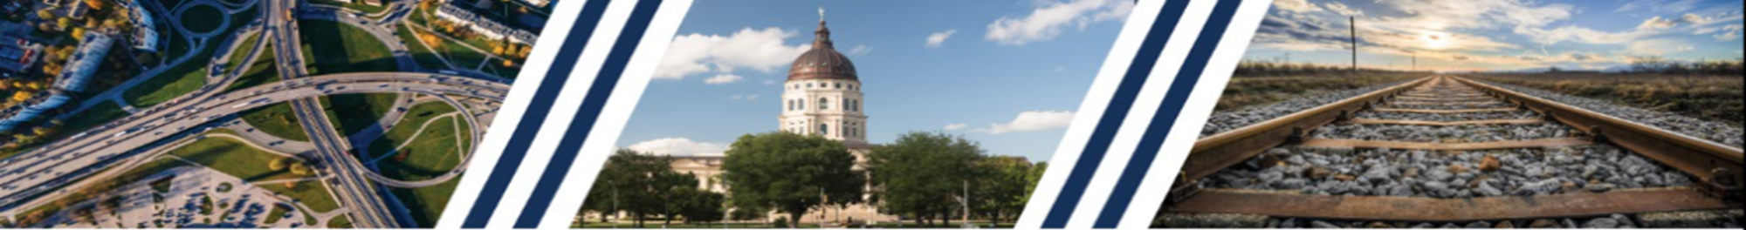
Joint Legislative Transportation
Vision Task Force
Michael White
October 30, 2018

Slide 2
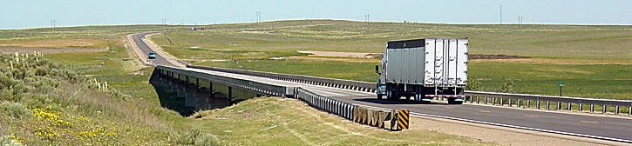
The Highway System
Statewide Quick Facts:
140,000 mile of public roads, 10,000 state highways
4th largest in the nation

Slide 3
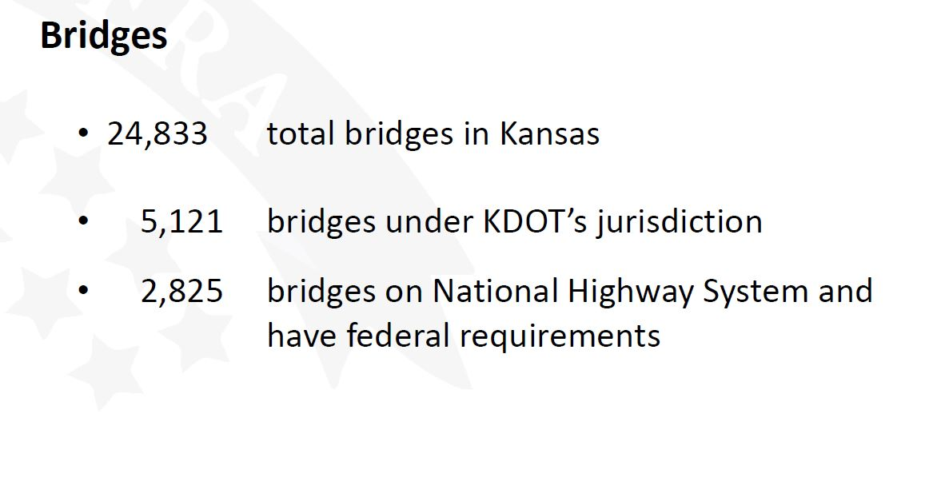

Slide 4
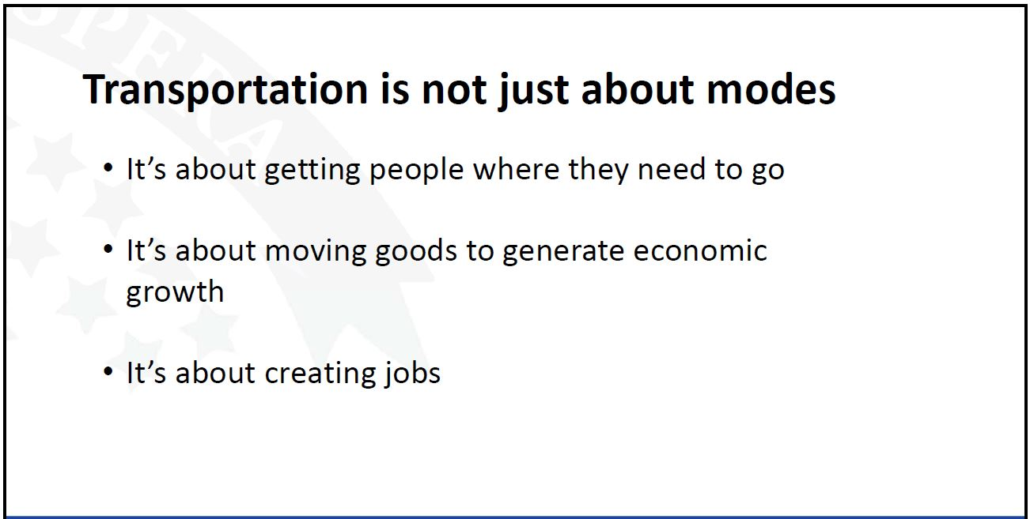
Kansans Understand The Importance of Transportation

Slide 5
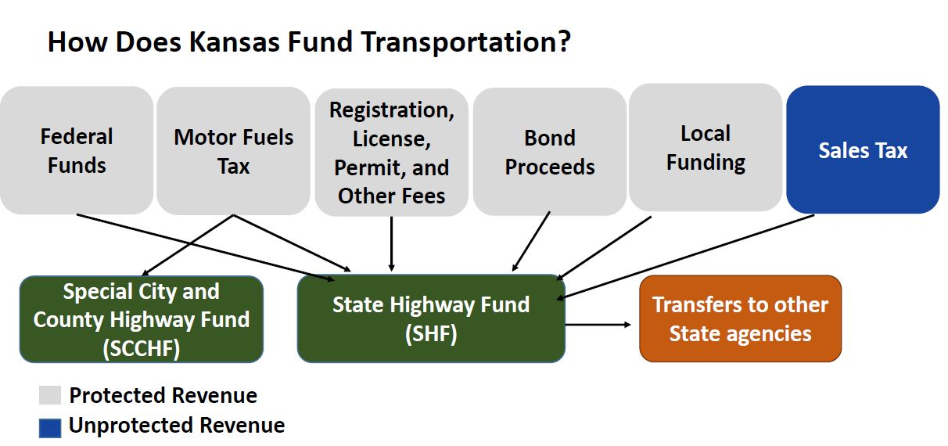

Slide 6
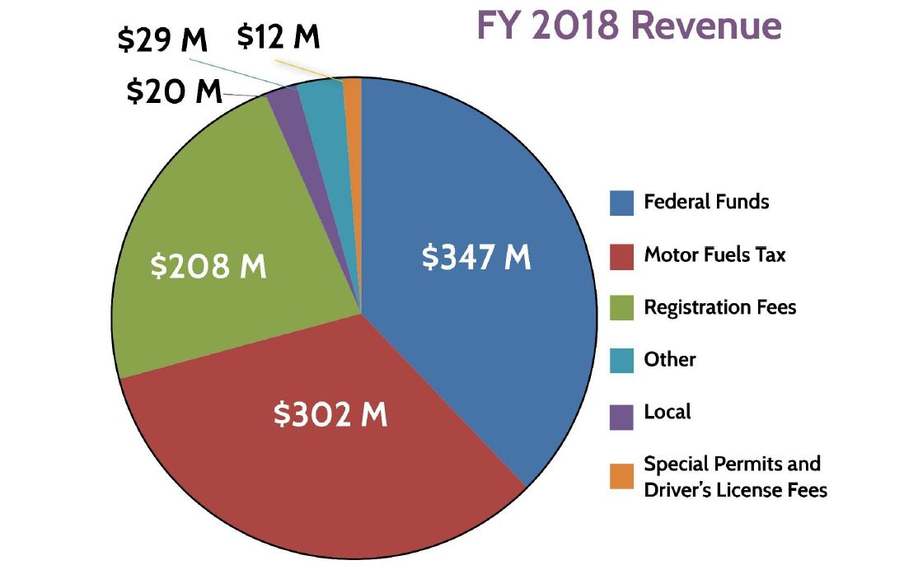
Dedicated State Highway Funds

Slide 7
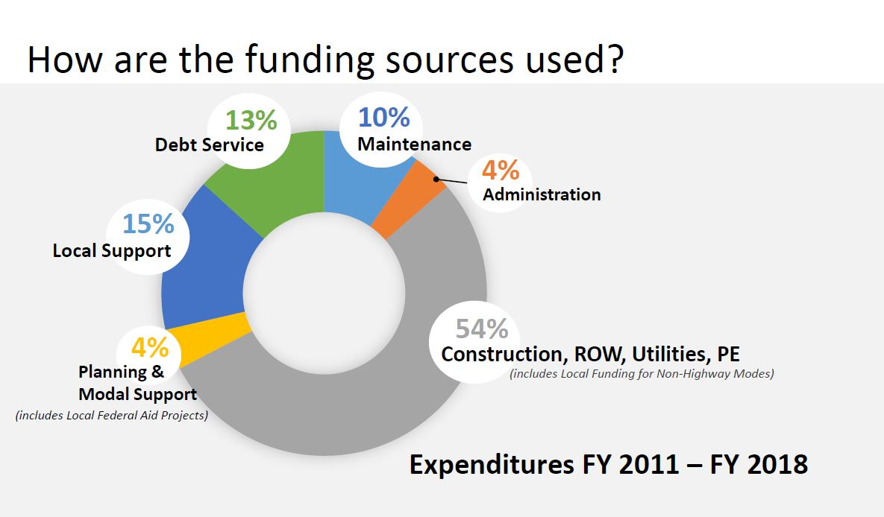

Slide 8
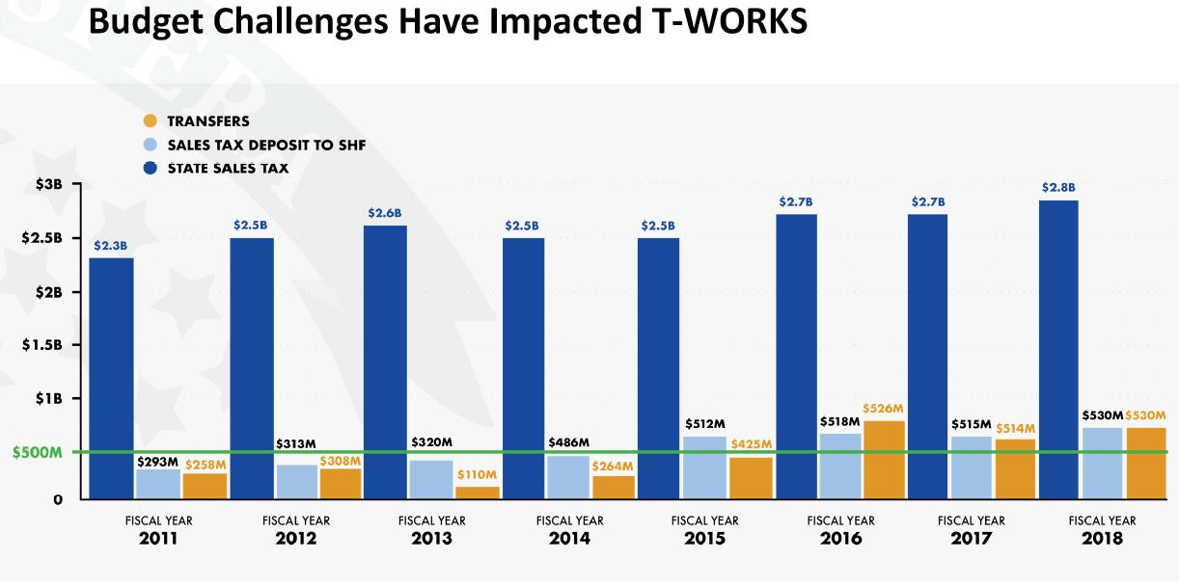

Slide 9
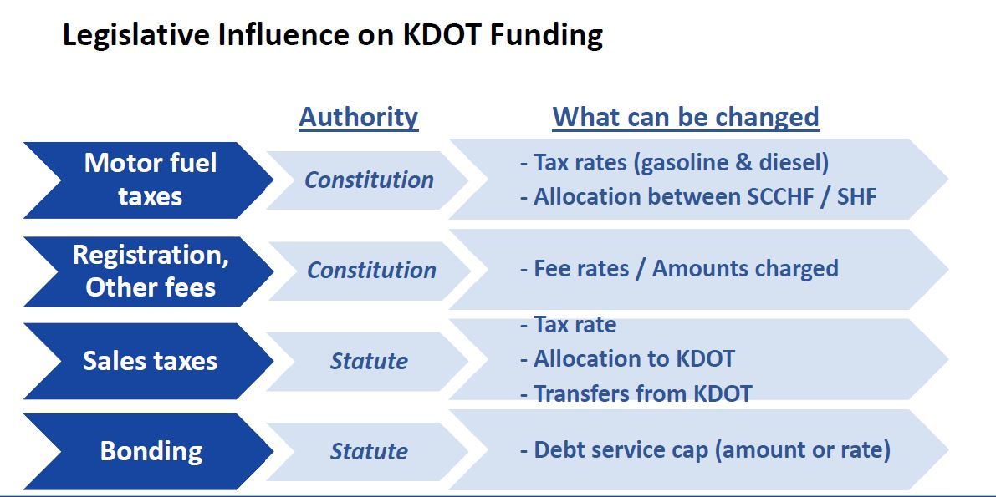

Slide 10
Comparison to neighboring states - disbursements
Source: FHWA Highway Statistics 2016
Notes:
http://www.trackstatedollars.org/

Slide 11
A History Of Advocacy
Comprehensive Highway Program (1989-1997) – $3.9 B Projects
Funding Highways & Transit
Focus on Preservation
Paid for by 7 cents MFT, $.25 sales tax, registration fees -50% cars, 33% trucks
$890 M in bonds
Comprehensive Transportation Program (2000-2009) –$ 12.9 B Projects
Funded Aviation and Rail for the first time
Focused on Expansion
4 cents MFT phased, $995 M in Bonds
Funding adjusted in 2002
increased MFT by 2 cents phased, $.45 increase in sales tax, registration fees - $5 for cars, $2-$10 trucks, $1.272 B in Bonds
Transportation Works for Kansas Program (2010-2020) –$ 8.2 B Program
Focus on Preservation & Economic Development
Funded with 1 cent sales tax, and registration increases,
bonding for 18% overall revenue
-cont-

Slide 12
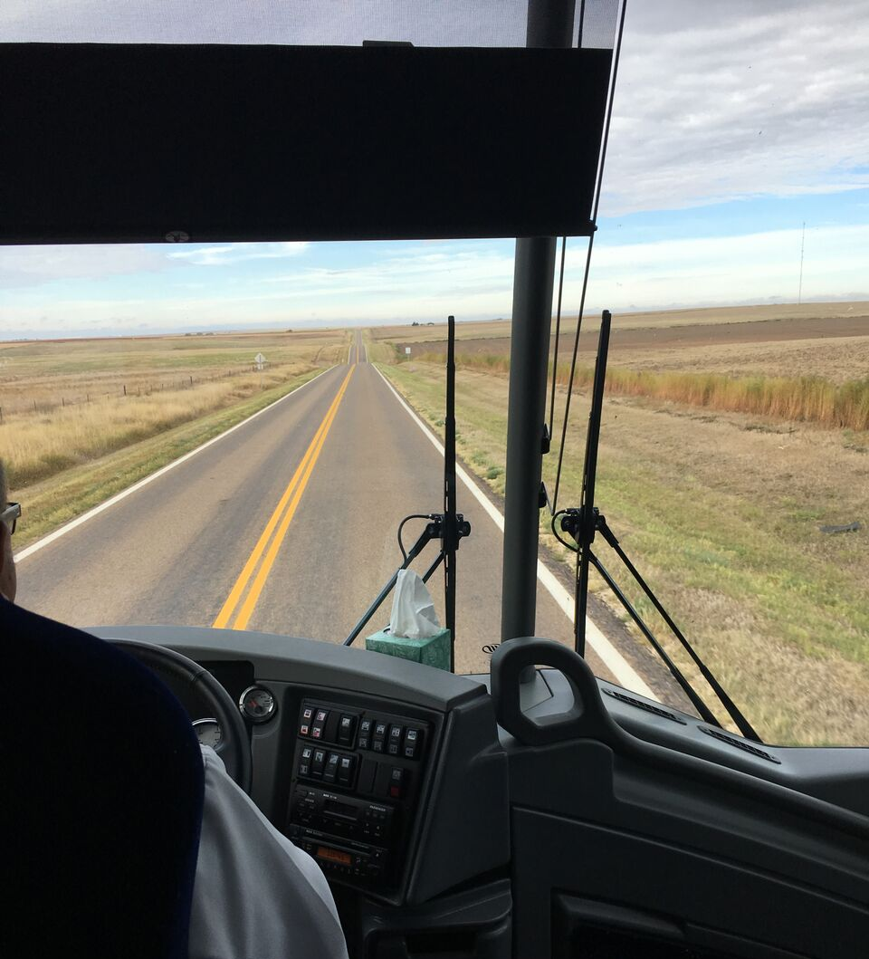
Industry Approach
Bus Tours held with legislators to educate about system conditions and funding needs.
Worked with the Legislature to secure an additional $60 million for transportation funding in the 2018 session.
2018 Task Force legislation to meet around the state to gather system needs and create momentum for a new transportation plan in 2019.

Slide 13

Transportation Task Force

Slide 14
Current Efforts
Transportation Task Force
  34 members: made up of public officials, industry representatives and stakeholders.
  Goals: to review current status of T-WORKS, current needs of the transportation system, travel the state gathering input on community needs and recommend funding for the system.
  Will make a recommendation following the meetings around the state in January 2019.

Slide 15
Task Force Members
  Co-Chairs: Senator Carolyn McGinn (R-Sedgwick) Representative Rich Proel (R-Labette)
  Elected Officials: Senators Rick Billinger (R-Goodland), Mike Petersen (R-Wichita), John Skubal (R-Overland Park), Pat Pettey (D-Kansas City), Tom Hawk (D-Manhattan). Representatives Shannon Francis (R-Liberal), JR Claeys (R-Salina), Adam Lusker (D-Frontenac), Troy Waymaster (R-Bunker Hill), Henry Helgerson (D-Wichita)
  Local Officials: Mayor Don Roberts of Edgerton, City Councilman Jon Daveline of Hutchinson, Commissioner Max Dibble of Phillips County, Commissioner Jim Allen of Johnson County, Commissioner Mike Brown of Johnson County
  At-Large Members: Kip Spray (Venture Corporation, Great Bend), Cameron McGown (HNTB, Overland Park), Mike King (Murphy Tractor, Hesston), Andy Sanchez (AFL-CIO, Topeka), Bridgette Williams (Heavy Constructors Association, KC), Lindsey Douglas (Union Pacific, Overland Park), Steve Sloan (Midwest Minerals, Pittsburg), Chad Girard (APAC, Hutchinson), Kenzil Lynn (Schwab Eaton, Salina), Ty Dragoo (Sheet, Metal, Air, Transportation Workers, Topeka), Alise Martiney (Greater KC Building Construction Trades, KC), Mary Birch (Lathrop & Gage, Overland Park), Matt Allen (City of Garden City), Jerry Younger (KAPA-KRMCA, Lawrence)
  Ex-Officio Members: Richard Carlson (KDOT Secretary), Sam Williams (KDOR Secretary), Jackie McClaskey (Agriculture Secretary), Steve Hewitt (Kansas Turnpike Authority CEO).

Slide 16
Estimated Funding Needed to Maintain the System
$600 million needed annually to maintain our system in its current condition
Preservation needs have increased because:
Transfers reduced the amount of preservation work completed
Transfers resulted in lighter actions & less pavement reconstruction
    95 miles less of heavy preservation work annually during T-WORKS
The amount of pavement and bridge deck area to preserve and maintain has increased substantially

Slide 17
Task Force Topics:
Funding
Current Highway Conditions
T-Works Progress
Modes
Demographics
Safety
Economic Development
Technology

Slide 18
We’re Over Half-Way Complete
Sept. 6
Salina
Sept. 20
Pittsburg
Oct. 11
Garden City
Oct. 24
Hays
Nov. 9 Manhattan
Aug. 6
Topeka
Sept. 12
Kansas City
Oct. 4 Newton
Oct. 18 Wichita
Nov. 8 Olathe
Nov. 28-29
Topeka

Slide 19
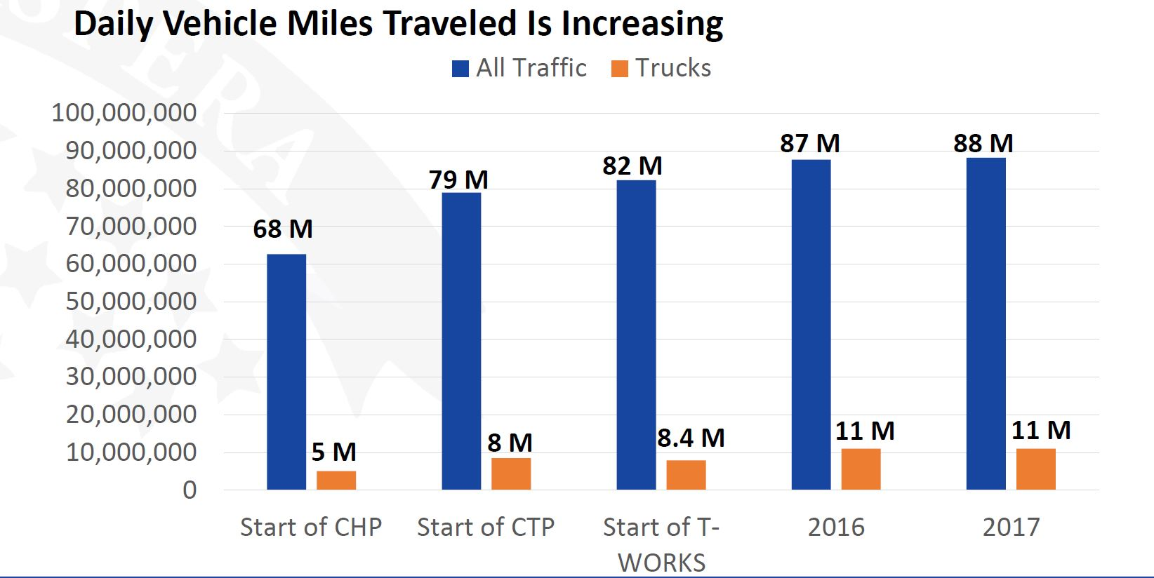


Slide 20
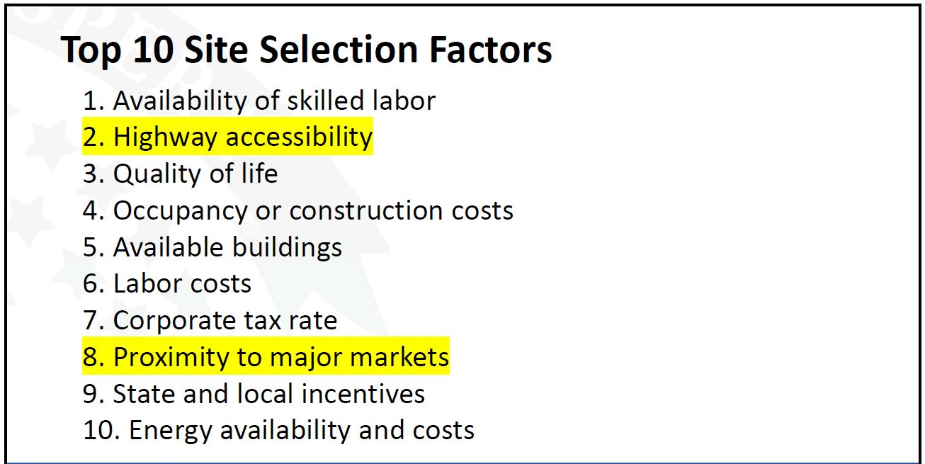

Slide 21
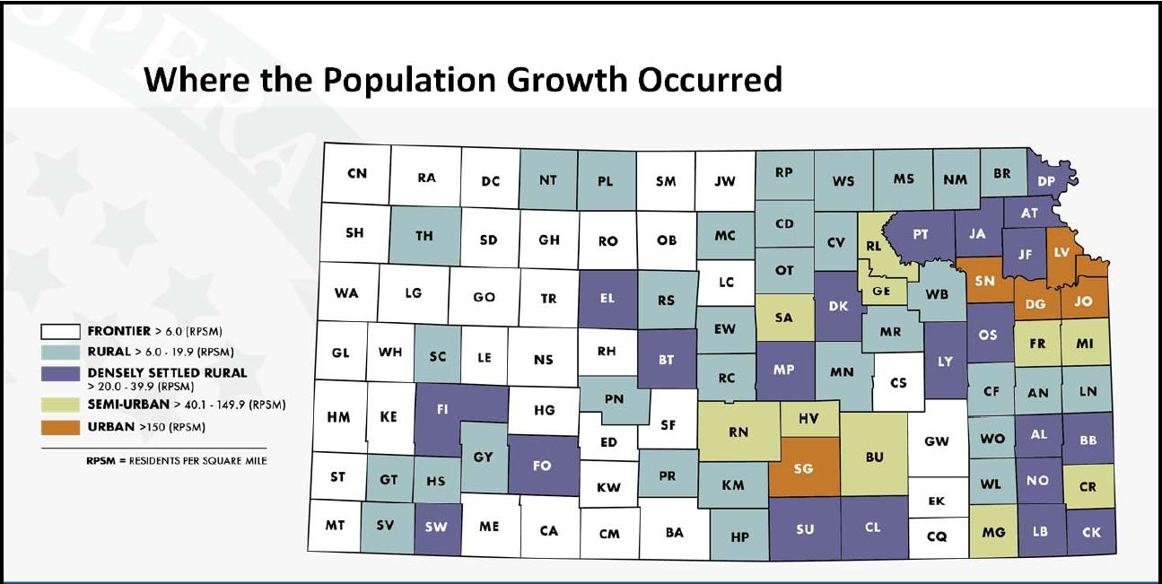

Slide 22
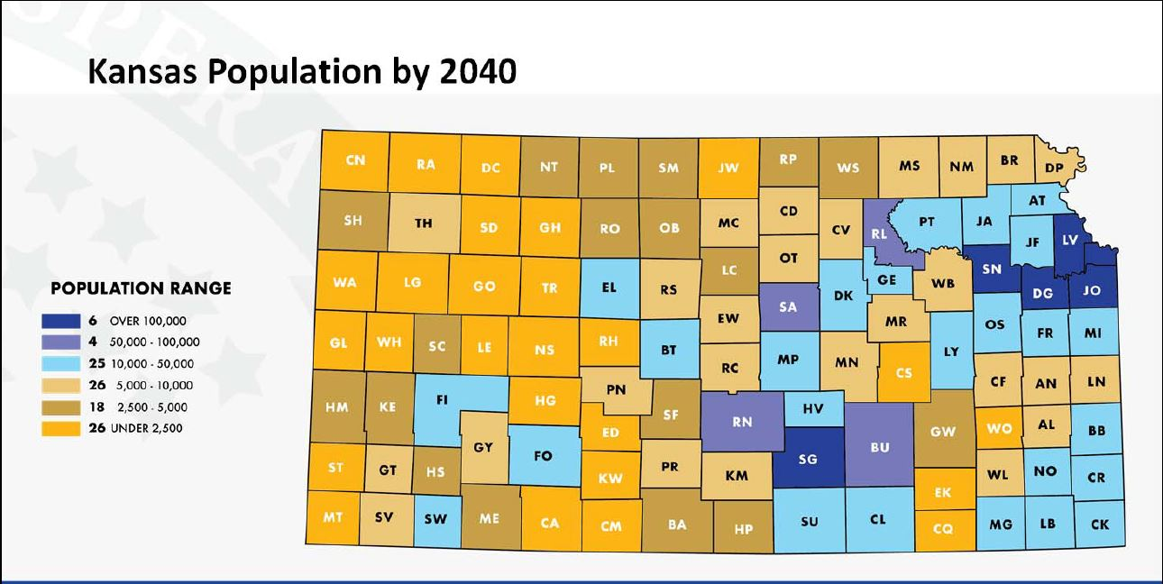

Slide 23
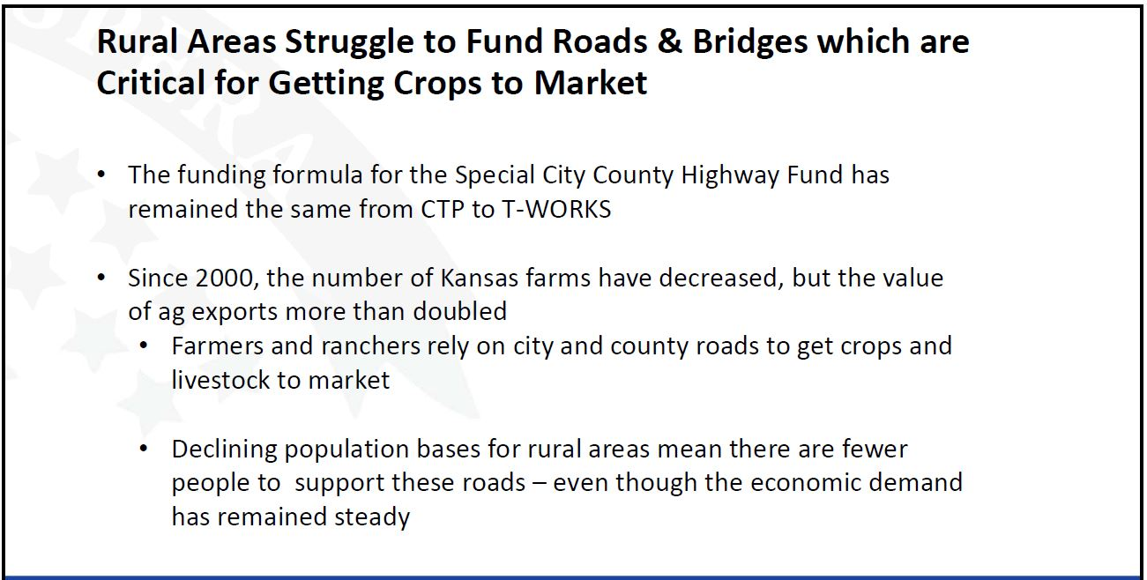

Slide 24
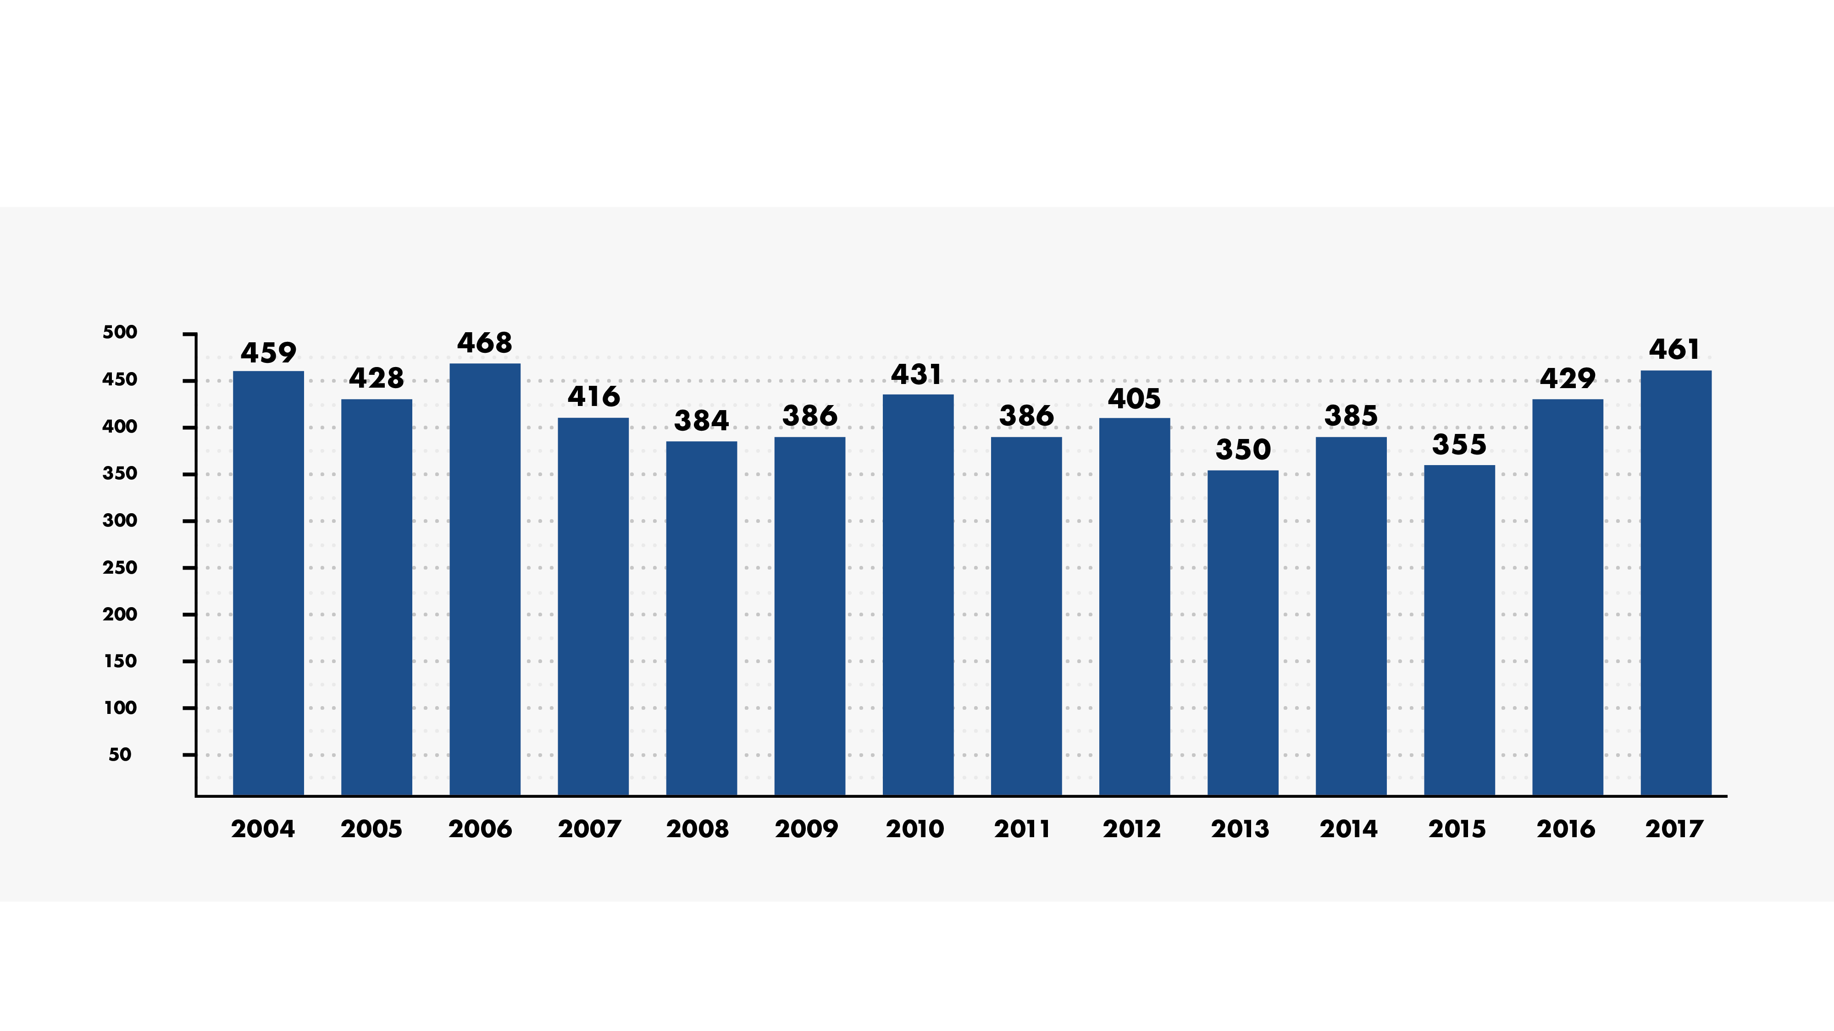
The Number of Traffic Fatalities Has Remained Mostly Steady
5-year (2013 to 2017) average = 396 fatalities

Slide 25
How Kansas Compares to Other States
State | Total Fatality Rate | Nat’l Rank | Rural Fatality Rate | Nat’l Rank | Urban Fatality Rate | Nat’l Rank
Colorado | 1.03 | 21 | 1.64 | 20 | 0.76 | 32
Iowa | 1.04 | 22 | 1.37 | 8 | 0.56 | 10
Nebraska | 1.14 | 26 | 1.51 | 12 | 0.64 | 18
Missouri | 1.15 | 28 | 1.64 | 22 | 0.80 | 35
Kansas | 1.22 | 29 | 1.97 | 38 | 0.51 | 5
South Dakota | 1.46 | 44 | 1.80 | 29 | 0.68 | 24

Slide 26
There Are Twice as Many Traffic Fatalities in Rural Areas
Rural defined as areas with less than 5,000 people

Slide 27
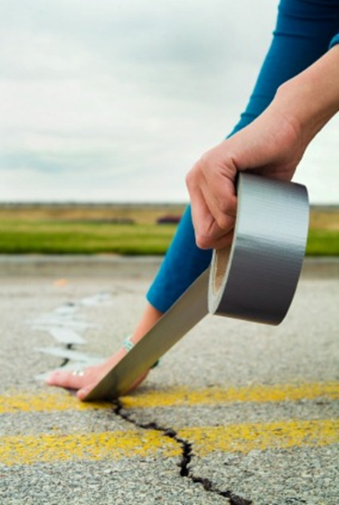
There is more work to do
We have 21 outstanding Tworks projects
There are still cash flow concerns
We still haven’t met minimum maintenance needs for several years

Slide 28
Investment Scenarios: 2021-2030
$13.3B
$2.4B
New Improvements
$11.9B
$600M
Complete T-WORKS
Complete T-WORKS
$11.3B
Preservation
Preservation
Preservation
$5.9B
Modal, Local & Other
Modal, Local & Other
Modal, Local & Other
$2.2B
Operations & Maintenance
Operations & Maintenance
Operations & Maintenance
$3.2B
Preserve, Operate & Maintain
Finish T-WORKS
New Improvements

Slide 29
Gap/Surplus for Scenarios by Transfer Amount
 | Revenue required for FY 2021 to 2030 | Ending Balance with Routine Transfers ($105M) | Ending Balance with $506.5 M transfers annually
Preserve, Operate & Maintain | $11.3 Billion | $1.6 billion | -$2.4 billion
Finish T-WORKS | $11.9 Billion | $1.0 billion | -$3.0 billion
New Improvements | $13.3 Billion | -$0.4 billion | -$4.9 billion

Slide 30
Positive Momentum from last session
  Addition $60M was added back towards the $600M worth of modernization/expansion projects currently on hold. Eliminating two of the projects that were previously on hold under T-WORKS.
  Federal Fund Exchange Program rate adjustment went back to the former 90-10 split.
  The Federal Government discussions on incentives for rural America.
  Trump focus on Transportation Funding.

Slide 31
Current Efforts & How Can You Get Involved:
Educational Awareness.
  Both public and legislators.
Let your elected officials know the importance of transportation.
Attend Task Force Meetings.
2019 Legislative Session – Pass a Comprehensive Transportation Plan.
  Funding
  Length
  Maintenance
  Modernization and Expansion
  All Modes (airports, public transit, rail, passenger rail, bicycle/pedestrian paths etc.)

Slide 32



Michael White, Executive Director @KansasRoads
Kansas Contractors Association
www.kansascontractors.org @KansasRoads

